Slide 1
Database Design and Management(it 2140)
Lecture 09 – Introduction to Non- relational databases

Slide 2
Lecture content
  Introduction to Non-Relational Databases
  Why NoSQL?
  NoSQL Databases
  Who uses NoSQL ?
  RDBMS vs NoSQL
  CAP Theorem
  BASE Concept
  Types of Non-Relational Databases
  Choosing NoSQL databases
  Current Trends in NoSQL Databases
  Challenges in Non-Relational Data Modelling

Slide 3
Learning outcomes
At the end of this lecture students should be able to
  Differentiate between relational and non-relational data models.
  Explain the need for NoSQL and CAP concepts.
  Identify and describe key types of non-relational databases.
  Discuss current trends and challenges in data modeling for NoSQL systems.

Slide 4
Introduction to Non-Relational Databases
Relational databases use tables, rows, and columns; perfect for structured data.
Modern systems need to handle massive, fast, and varied data (Big Data, IoT, social media).
Non-Relational Databases (NoSQL) emerged to handle:
  High scalability & availability
  Flexible schema for unstructured data
  Distributed storage across clusters
Examples: MongoDB, Cassandra, Redis, Neo4j

Slide 5
Why NoSQL?
Traditional RDBMS struggles with:
  Large, distributed datasets
  Real-time and high-velocity data
  Dynamic or unstructured data models
Web companies (Google, Amazon, Facebook) built internal scalable systems (e.g., BigTable, DynamoDB).
NoSQL provides horizontal scaling, replication, and eventual consistency

Slide 6
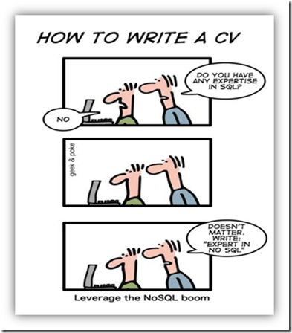
NoSQL Databases
“NoSQL is an accidental term with no precise definition”
  first used at an informal meetup in 2009 in San Francisco (presentations from Voldemort, Cassandra, Dynomite, HBase, Hypertable, CouchDB, and MongoDB)
[Sadalage & Fowler: NoSQL Distilled, 2012]

Slide 7
NoSQL Databases
NoSQL: Database technologies that are (mostly):
  Not using the relational model (nor the SQL language)
  Designed to run on large clusters (horizontally scalable)
  No schema - fields can be freely added to any record
  Open source
  Based on the needs of 21st century web estates
[Sadalage & Fowler: NoSQL Distilled, 2012]
Other characteristics (often true):
  easy replication support (fault-tolerance, query efficiency)
  simple API
  eventually consistent (not ACID)

Slide 8






Who uses NoSQL ?

Slide 9
RDBMS vs NoSQL
RDBMS | NoSQL
Structured and organized data | Unstructured or semi structured data
Structured Query Language (SQL) | No declarative query language
Schema - centric | Schema - free
Data and its relationships are stored in separate tables | Distributed storage
Complex data relationships | Very simple relationships
Joins | Avoid joins
Database-centric | Application-centric or developer-centric
Well defined standards | Standards not yet evolved

Slide 10
CAP Theorem

Slide 11
CAP Theorem
Consistency : data in the database remains consistent after the execution of an operation
e.g : after an update operation, all clients see the same data
Availability : system is always on
Partition Tolerance : system continues to function even the communication among the servers is unreliable

Slide 12
BASE Concept
BASE is vague term often used as contrast to ACID
Basically Available
The system works basically all the time
Partial features can occur, but without total system failure
Soft state
The system is in flux, non-deterministic state
Changes occur all the time
Eventual consistency
The system will be in some consistent state
At some time in future

Slide 13
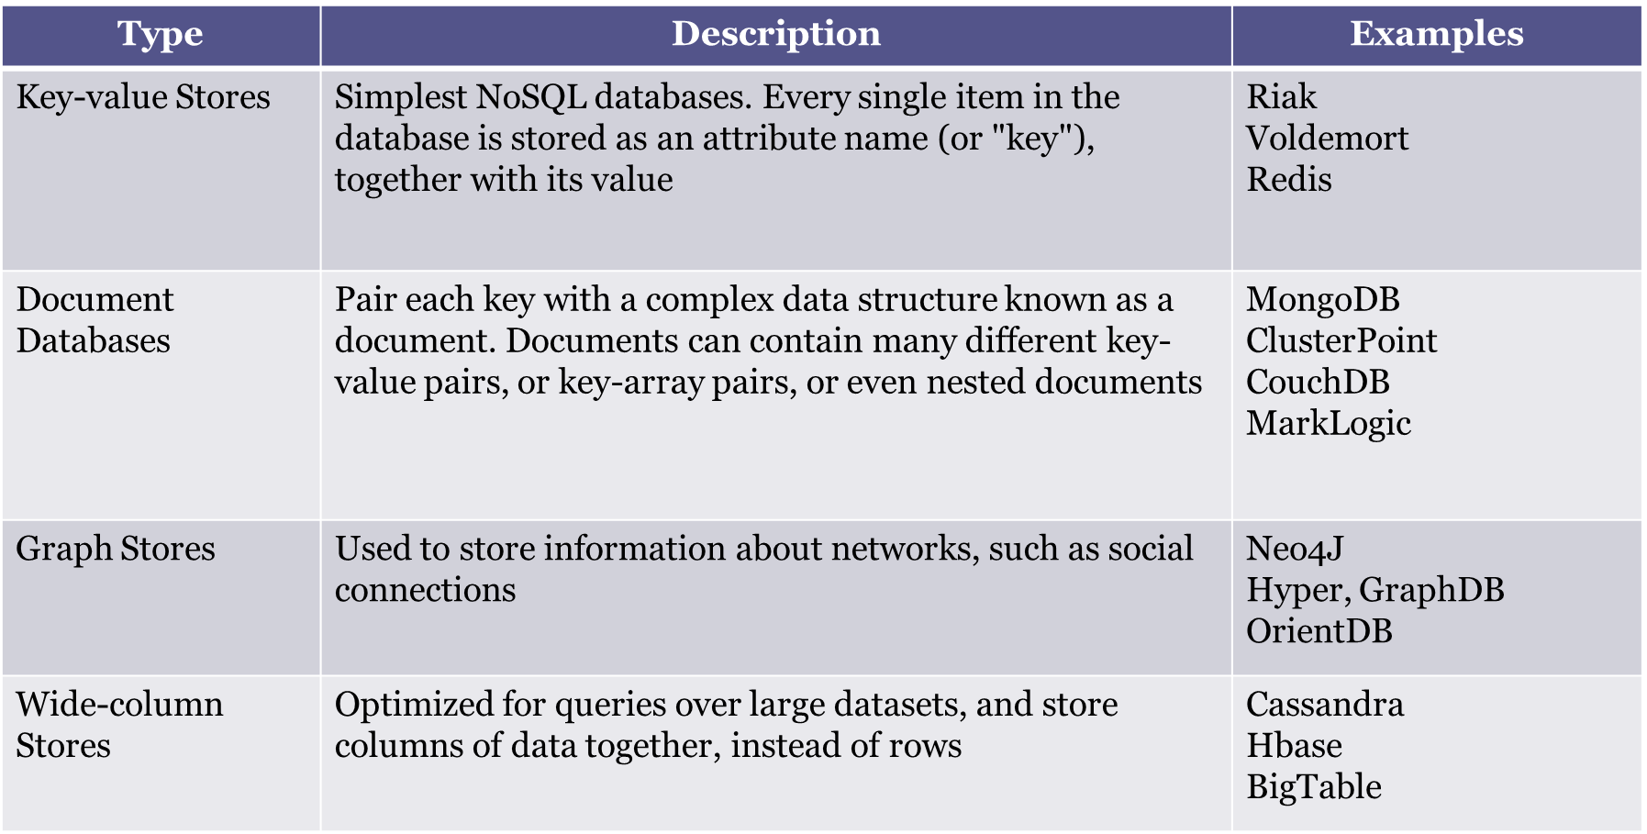
Types of Non-Relational Databases

Slide 14
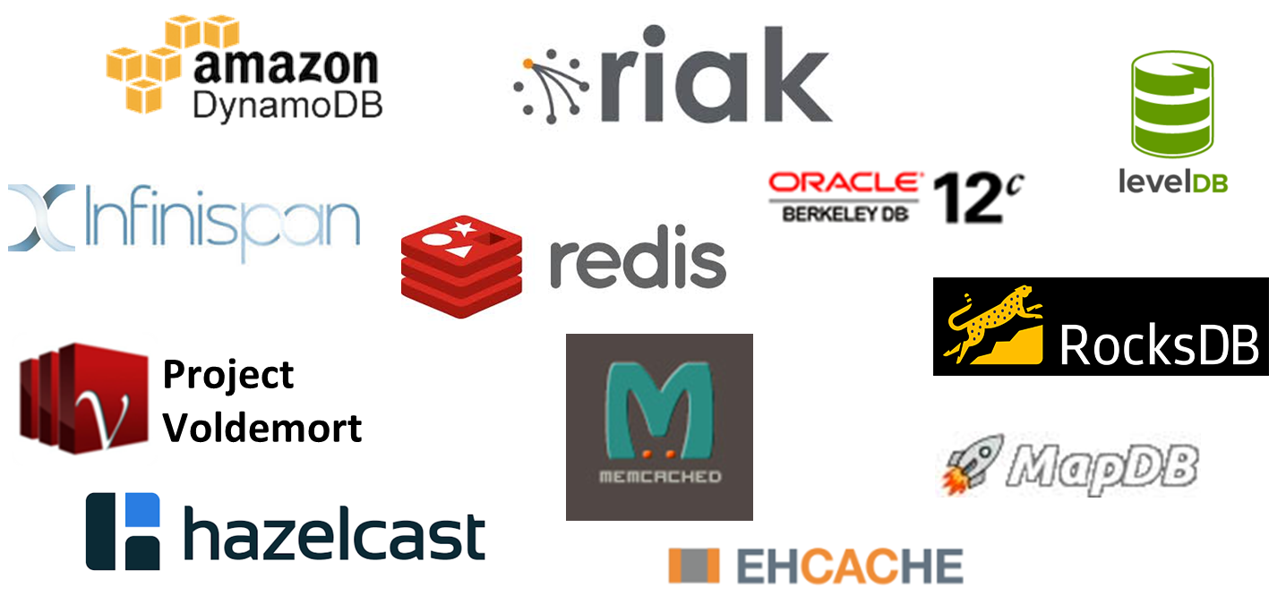
Key - Value Stores: Representatives

Slide 15
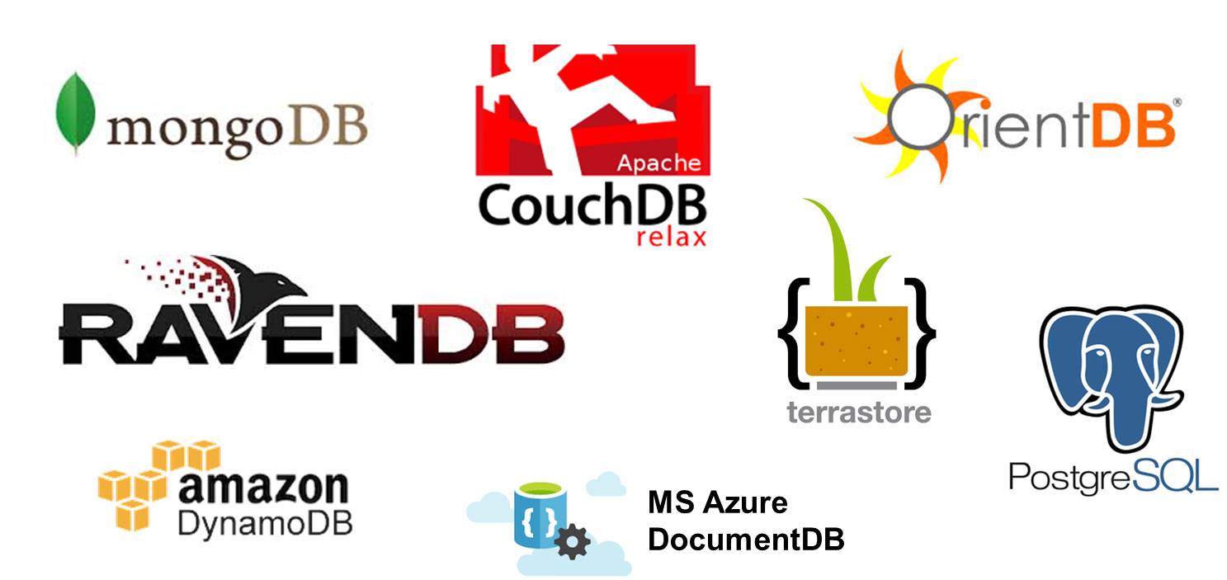
Document Databases: Representatives

Slide 16
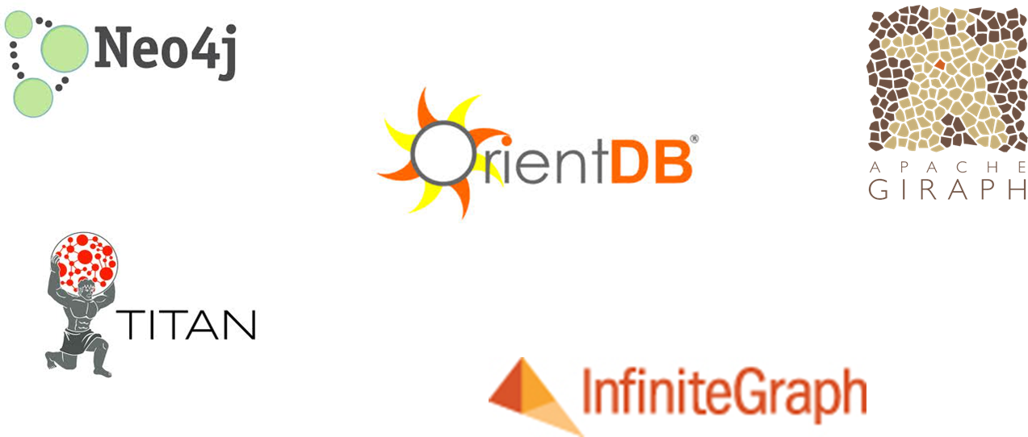
Graph Databases: Representatives

Slide 17
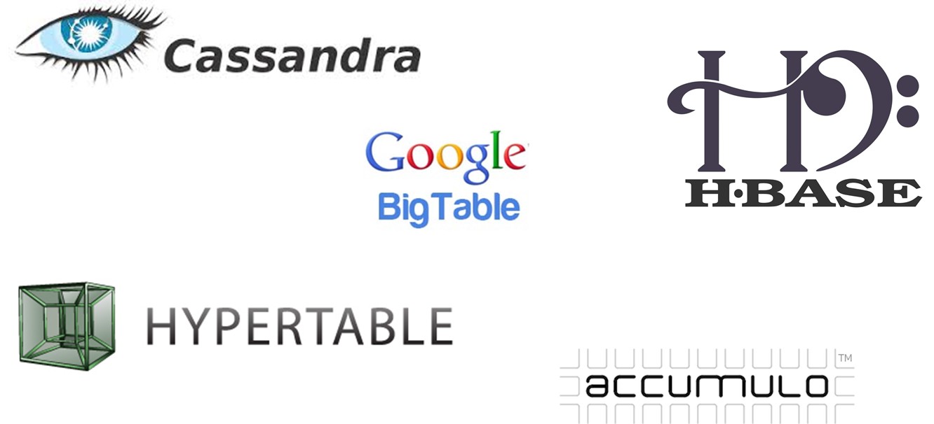
Column-family Stores: Representatives

Slide 18
Reasons to choose NoSQL databases
To improve programmer productivity by using a database that better matches an application’s needs.
To improve data access performance via some combination of handling larger data volumes, reducing latency and improving throughput.

Slide 19
Choosing NoSQL databases
It depends on the system requirements and here are some general guidelines.
Key-value databases are generally useful for storing session information, user profiles, preferences, shopping cart data.
Document databases are generally useful for content management systems, blogging platforms, web analytics, real-time analytics, ecommerce-applications.
Column family databases are generally useful for content management systems, blogging platforms, maintaining counters, expiring usage, heavy write volume.
Graph databases are vey well suited to problem spaces where we have connected data such as social networks, special data, routing information for goods and money, recommendation engines.

Slide 20
Current Trends in NoSQL Databases
Multi-Model Databases – support multiple data types (e.g., ArangoDB).
Serverless Databases – auto-scaling NoSQL in the cloud (Firebase, DynamoDB).
Integration with AI & Analytics – real-time data pipelines.
Polyglot Persistence – using both SQL and NoSQL in hybrid systems.
Increased focus on data governance and consistency.

Slide 21
Challenges in Non-Relational Data Modelling
Lack of standard query languages.
Difficulty enforcing relationships.
Eventual consistency complicates real-time data.
Migration from relational to NoSQL requires re-designing schema logic.
Limited trained expertise and tooling compared to RDBMS.

Slide 22
References
Sadalage, P. J., & Fowler, M. (2012). NoSQL Distilled: A Brief Guide to the Emerging World of Polyglot Persistence. Addison-Wesley Professional.
Pramod Sadalage, NoSQL Databases : An Overview, http://www.thoughtworks.com/insights/blog/nosql-­‐ databases-­‐overview.

Slide 23
What you have to do by next week
Try out the self-test questions on the course web.
Complete the tutorial.

